Slide 1
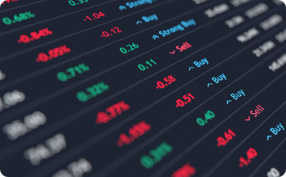

Stock Market Analysis
Submitted To:
Project Mentor: Ms. Garima Garg
Project Coordinator: Mr. Sumit Kumar
Submitted By:
Aaditya Sharma(21ESKCA002)
Ansh Tyagi(21ESKCA017)
Bhavya Gupta (21ESKCA032)

Slide 2
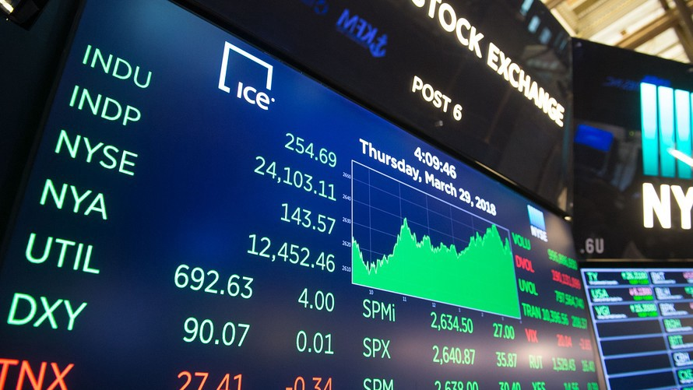
Objective
Built and trained an LSTM model using 10 years of stock data, focusing
on price changes and incorporating technical indicators like RSI, MACD,
Bollinger Bands, SMA, and EMA.
Designed the mobile app for a smooth user experience with live prices, historical trends, and future predictions.
Backend built with Flask, handling data analysis, user authentication,
and app communication.
The app offers insights and visualizations, suitable for both beginners
and experienced traders.

Slide 3

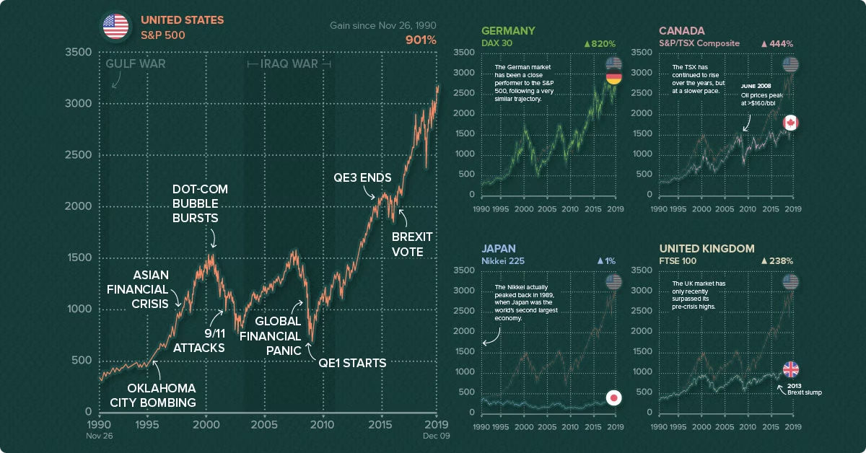
Problem Statement
We have developed a mobile application that predicts stock prices using machine learning, combining an Android frontend, a Flask backend, and an LSTM-based model. The app uses historical stock data to train the model, which processes user queries and delivers predictions in real-time. Integrated with Yahoo Finance for up-to-date data, the app ensures accurate and personalized predictions, with secure user authentication and activity logs. This project showcases the power of machine learning, mobile, and web technologies to provide accessible stock insights for users, even those with limited technical knowledge. It serves as a foundation for future improvements, such as advanced analytics and personalized suggestions.

Slide 4

Literature Review Summary
A comprehensive literature review was conducted to analyze existing approaches to stock price prediction. The review covered various machine learning techniques, including linear regression, support vector machines, and neural networks.
Technique | Strengths | Weaknesses
Random Forest | Ensemble-based approach | Can be inaccurate for complex datasets.
Support Vector Machines | Effective for high-dimensional data, robust to outliers. | Can be computationally expensive.
LSTM | Powerful for non-linear relationships, can handle complex data. | Requires large datasets for training, can be difficult to interpret.

Slide 5
Methodology
Data Collection
Data Preprocessing
Machine Learning
Backend Development
Features Extraction
Application Development
Data Collection: We gather historical stock prices and trading volumes from sources like Yahoo Finance. The data is updated regularly to maintain prediction accuracy.
Data Preprocessing: The data is cleaned by handling missing values, removing outliers, and normalizing features. It is then split into training and testing sets.
Feature Extraction: Key indicators such as moving averages, trends, and volatility are extracted to help the model identify meaningful patterns in stock movements.
Machine Learning Model: We use models like Linear Regression and SVM to predict future stock prices, evaluating performance with metrics like Mean Absolute Error (MAE).
Backend Development: The Flask-based backend manages user authentication, real-time stock price predictions, and integrates features like news, watchlists, and live data for 20 Indian tickers.
Application Development: A Kotlin app provides users with real-time stock predictions.

Slide 6






Implementation Details
The system will be implemented using Python and libraries like Pandas, NumPy, and Scikit-learn. The model will be trained using a combination of technical indicators and fundamental data. These include moving averages, RSI, MACD, company earnings, and revenue.
Tech Stack
Technical Indicators
Python for ML and data processing
Kotlin for Android app UI
Flask for backend APIs
Moving average, Relative Strength Index, Moving average convergence divergence, Simple Moving Average, Economics Moving Average
Fundamental Data
Model Training
Company earnings, revenue, and other financial metrics will be considered to assess the company's financial health.
The model will be trained using supervised learning techniques, with historical data as input and future prices as output.

Slide 7
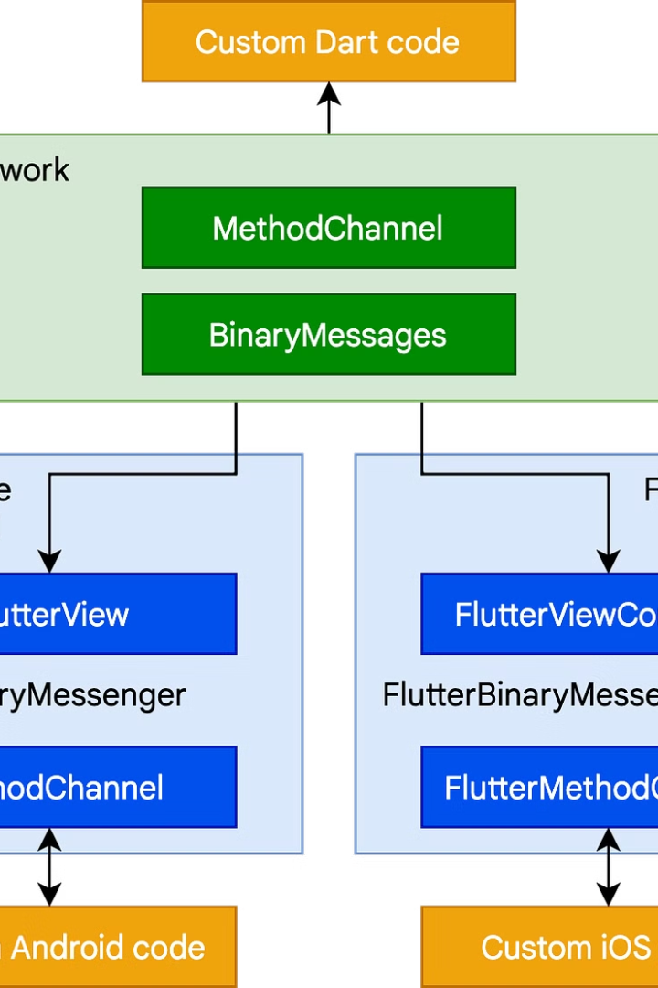
System Architecture and Integration
Flask Backend
APIs for data, predictions, user management.
Mobile App
Kotlin UI for visualizing data and news.
Database
Stores historical data, user profiles, watchlists.
Live Data
Integrated with financial APIs for real-time updates.

Slide 8
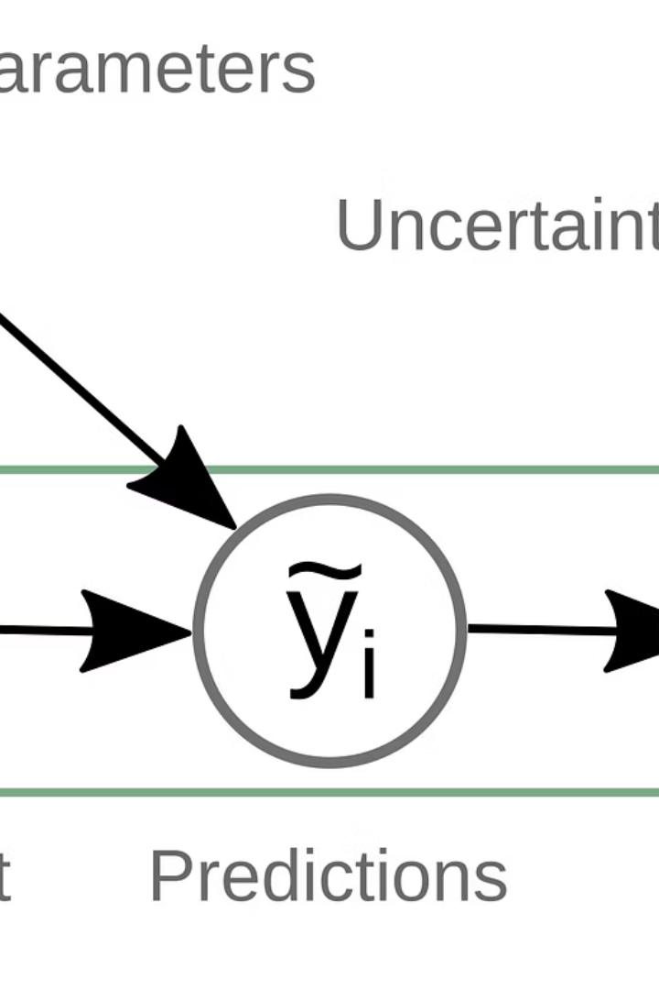
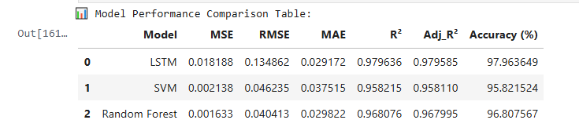
Results & Performance Evaluation
LSTM showed highest accuracy and good efficiency on 365-day test data.

Slide 9
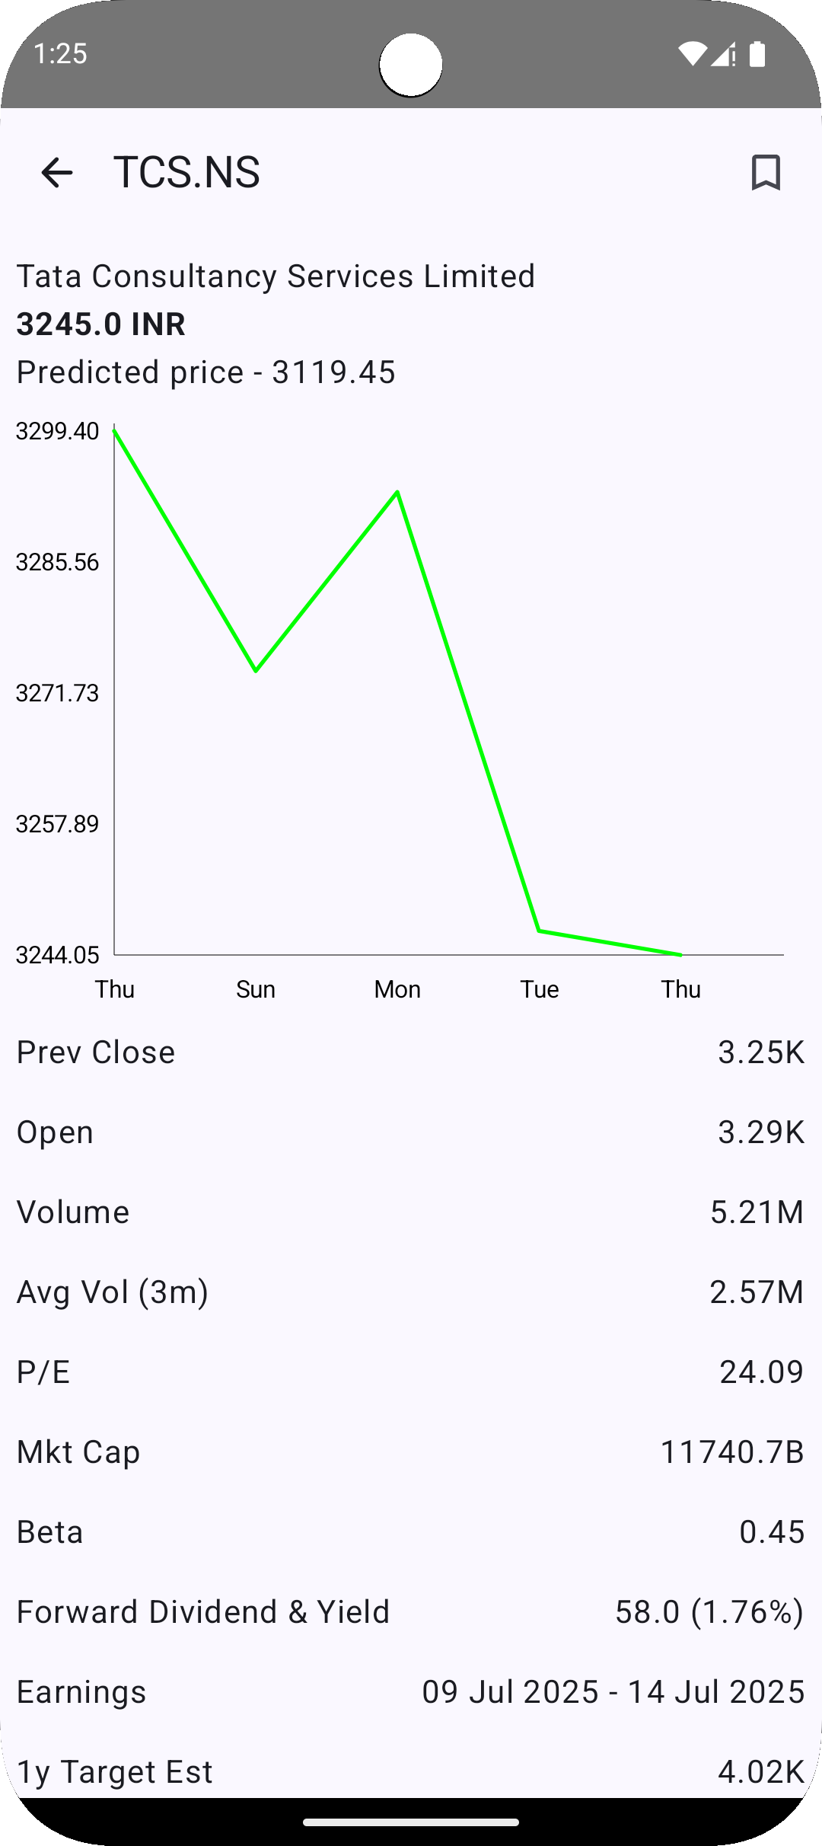
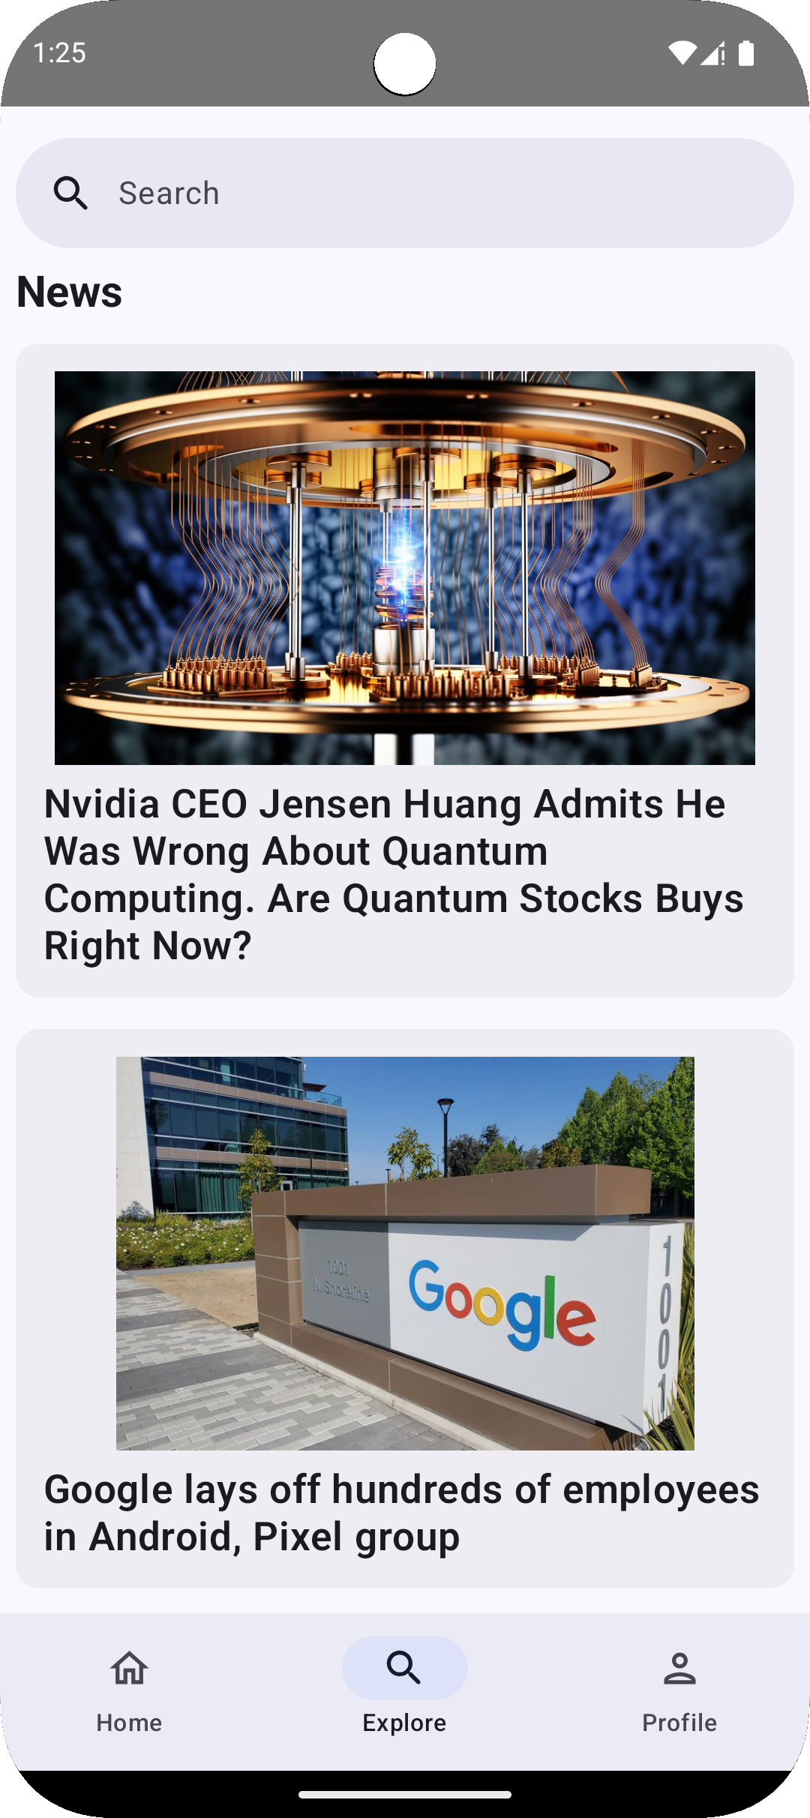
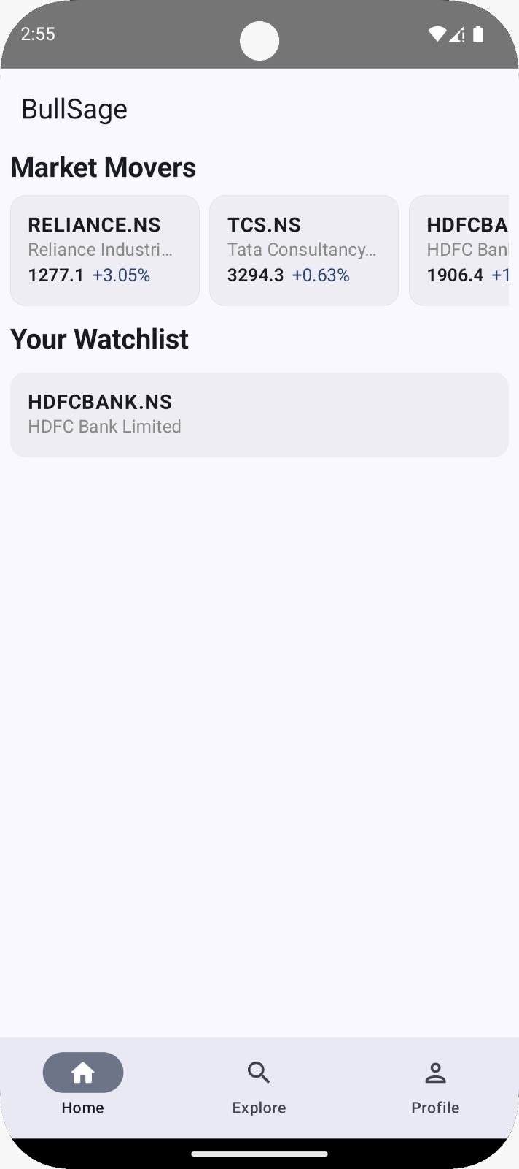
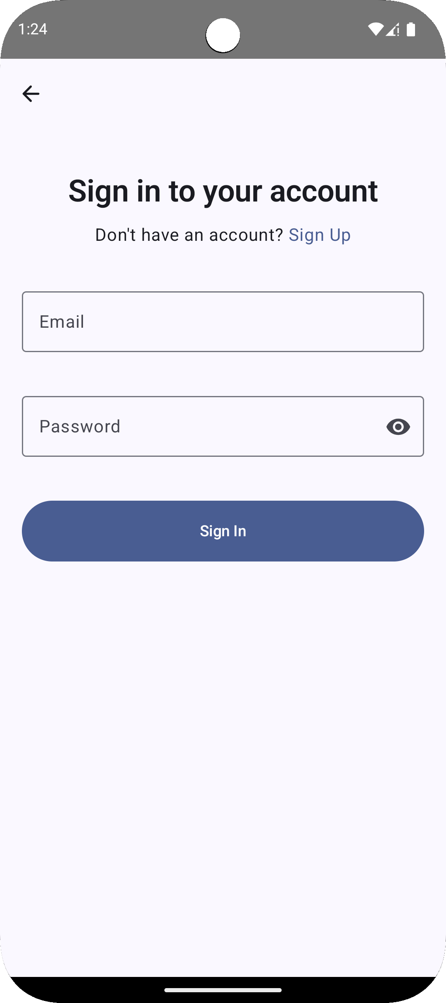
App Photos: Interface and Key Features
Stock Detail
News Feed
Watchlist
Login & Signup
Historical charts and ML predictions.
Latest market news and updates.
Manage favorite stocks and portfolios.
Secure user authentication pages.

Slide 10

Future Scope
Platform Expansion
iOS and web app development for wider reach.
Sentiment Analysis
Analyze news and social media for better predictions.
Portfolio Tracking
Feature to monitor investments and profits.
Smart Alerts
Notifications for critical price changes and events.

Slide 11
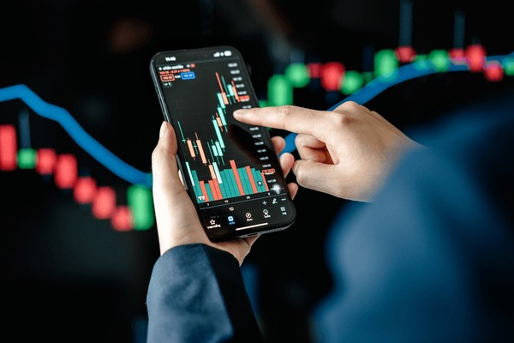
Conclusion
A mobile application was developed to predict stock prices using an LSTM model, with an Android frontend and Flask backend.
The model is trained on historical stock data to recognize market trends, and predictions are generated instantly through the Flask API.
Yahoo Finance is integrated for real-time data, and user authentication and activity tracking are handled securely via a backend database.
The project showcases the practical use of ML, mobile, and web technologies, laying the groundwork for future features like advanced analytics and multilingual support.

Slide 12
Thank You Any Query ?

